Slide 1

Super Store SALES PREDICTION
Revanth Kumar Santi

Slide 2
Data Info
Shape of Data: 2121*21
15 categorical columns and remaining numerical
Duplicate rows:1
Null Values:0
Unique column: Row ID

Slide 3
Data Preprocessing
Change the Row ID into Index
Convert date columns into datetime format
Delete duplicates
Delete Country and Category columns as it contains single value
Delete 'Order ID','Customer ID','Customer Name','Product ID’ as it was not showing any significance
New shape: 2120*14

Slide 4
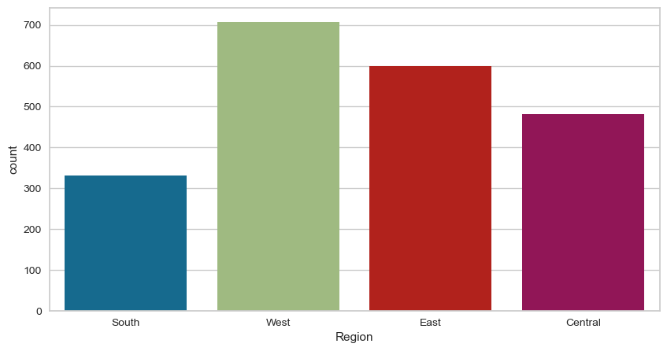
Exploratory Data Analysis

Slide 5
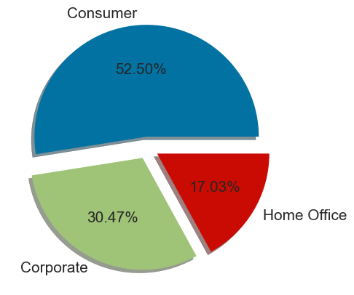
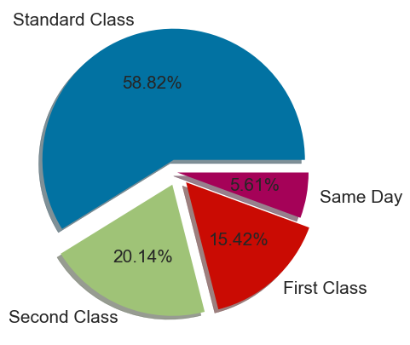

Slide 6
Standard Class has the highest count, indicating it is the most frequently used shipping mode.
Consumers has the highest count.
Furnishings are most preffered furniture type

Slide 7
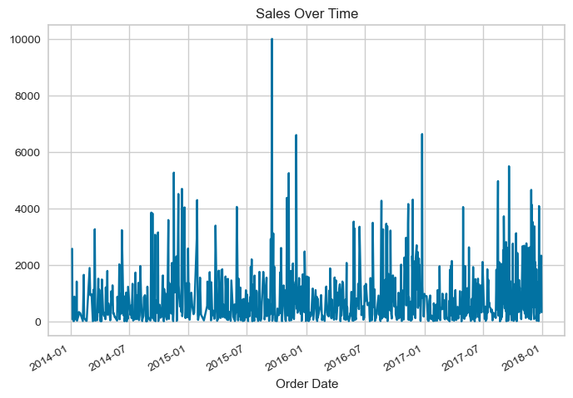
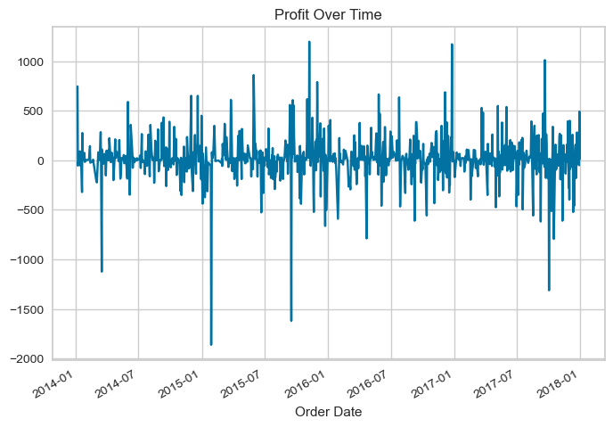
The highest sales appears to occur in late 2015 and also we are seeing greater loss in early 2015

Slide 8
Model Training
Model | R2 | MAE | MSE | RMSE
ExtraTreeRegressor | 0.987 | 0.104 | 2801.23 | 52.92
XGBRegressor | 0.981 | 0.138 | 3996.00 | 63.21
NGBRegressor | 0.978 | 0.169 | 4548.03 | 67.43

Slide 9
Thank You

